Slide 1

Government Engineering College Bikaner
(Rajasthan Technical University, Kota)
Department of Computer Science Engineering
Presented By:
Rajat Dubey
14EEBCS060
Batch-B2

Slide 2
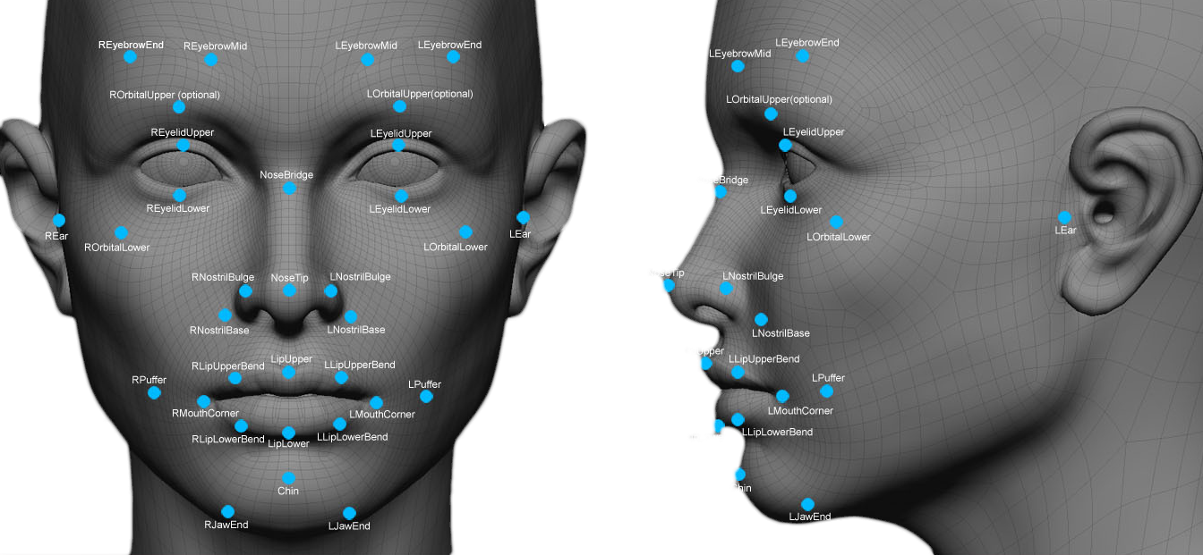
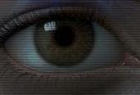
Real-Time Facial Recognition
MATCH!

Slide 3
Topics of Discussion
Face Recognition
Why real-time face recognition?
What is difficult about real-time face recognition?
Principle Component Analysis and Linear Descriminant Analysis
Tools
Other face recognition algorithms
Future of face recognition
Result

Slide 4
Face Recognition
"Face Recognition" generally involves two stages:
Face Detection, where a photo is searched to find any face (shown here as a green rectangle), then image processing cleans up the facial image for easier recognition.
Face Recognition, where that detected and processed face is compared to a database of known faces, to decide who that person is (shown here as red text).
Define: Face recognition system is a computer application for automatically identify or verifying a person from a digital image or video frame. In this system automatically searching of faces from the face databases, typically resulting in a group of facial images ranked by computer evaluated similarity.

Slide 5
Why Real-Time Face Recognition?
Security
Fight terrorism
Find fugitives
Personal information access
ATM
Computer System
Home access (no keys or passwords)
Any other application that would want personal identification
Improved human-machine interaction
Personalized advertising
Beauty search

Slide 6
What Is Difficult About Real-Time Face Recognition
Lighting variation
Orientation variation (face angle)
Size variation
Large database
Processor intensive
Time requirements

Slide 7
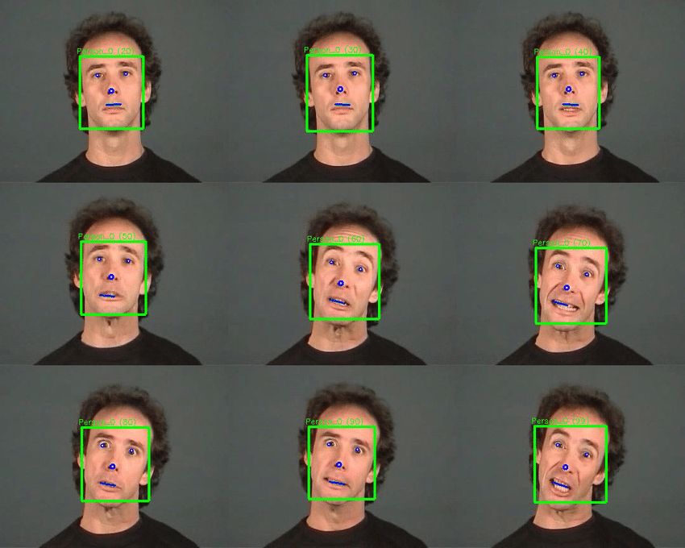
Face Detection
Face Registration
Frames form a face sequence
Illumination Normalization
Match!
Information Fusion
Face Verification
Final Decision
Not Match!

Slide 8
Principle Component Analysis(PCA) and Linear Descriminant Analysis(LDA)
PCA also known as Karhunen Lower Transformation is used to reduce the dimensionality. Its main aim is to reduce the data onto lower dimensional space also called as Eigen space by computing the Eigen values and Eigenvectors of dataset. The output of PCA is the input to LDA algorithm. It is based on Eigen value and Eigenvector.
The LDA computes the scatter matrix within class and scatter matrix between class thus separating the images within class increasing the recognition rate. After calculating the weight matrix Euclidian distance is calculated.
The PCA and LDA algorithms are based on an efficient computation of Eigen values and Eigenvectors. Many methods are used to compute Eigen value and Eigenvectors such as QR method, Gauss-Seidel method, Power method, Jacobi method etc. The Jacobi method is an iterative method to find eigen value and eigenvector of symmetric matrix.

Slide 9
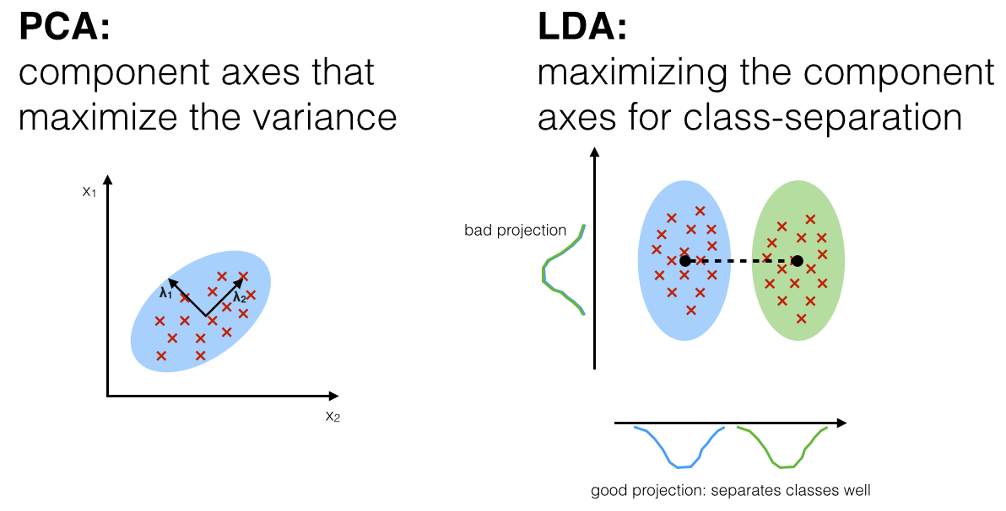
Euclidian Distance

Slide 10
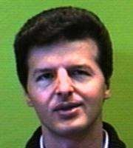
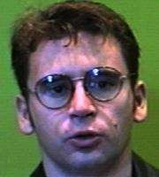


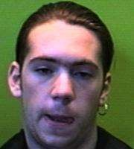
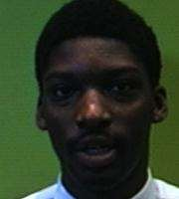
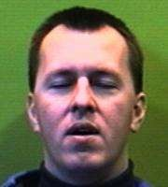

Representing EigenFaces
⎛ a₁ ⎞
⎛ c₁ ⎞
⎜ _{a} ⎟
⎜ _{c} ⎟
₌ ⎜ ⎟
⎜ ⎟
₌ ⎜ ⎟
⎜ ⎟
2
2
⎜ _{a} ⎟
⎝ N ² ⎠
⎛ b₁ ⎞
⎜ _{c} ⎟
⎝ N ² ⎠
⎜ _{b} ⎟
₌ ⎜ ⎟
⎜ ⎟
2
⎜ _{b} ⎟
⎝ N ² ⎠
⎛ d₁
⎛ e₁ ⎞
⎞
⎜ ⎟
⎟
⎜ ⎟
⎜ _{e} ⎟
_{= ⎜} d₂
₌ ⎜ ⎟
2
⎜ ⎟
⎜ _{d} ⎟
⎝ N ² ⎠
⎜ _{e} ⎟
⎝ N ² ⎠

Slide 11
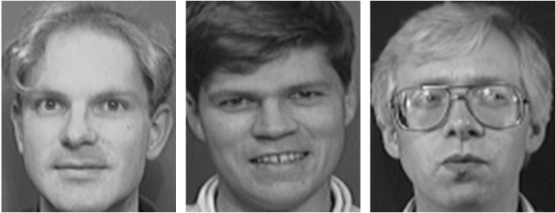
Fig: Design Flow of Training Module
Set of Database Images
Convert Image into Grayscale
Filter the image using Gaussian Filter
Let
X
Normalize image by Subtracting mean
Convert image into Face Vector
PCA and LDA
Database

Slide 12
In above Block Diagram the Training module consists of Gray scale conversion module where in all colour images are converted into Gray scale images, a Gaussian filter module to filter the image using gaussian mask, Normalisation Module by subtracting the mean of all images from each image to normalize faces, and vector conversion module that convertes 2D image are converted into 1D row vector.
Next the PCA followed by LDA algorithms are applied onto images after which database of images is obtained. This completes the Training phase of face recognition system.

Slide 13
Fig: Design Flow of Recognition Module
Unknown Image
X
Transfer Image Onto LDA Space
Database
Euclidian Distance
Is
D<Dt
Recognized
Yes
No
Unknown

Slide 14
During the recognition phase of Face Recognition system the unknown face is first converted into gray scale. Next the test image is smoothened using Gaussian filter. Test image is normalized by subtracting the mean of images from test image. Now the image is converted from 2D to 1D row and then is transferred to LDA surface space by multiplying weight of PCA and LDA.
Euclidian distance is calculated between the LDA sub space of test image and all the LDA subspace images in the database. The minimum distance image is classified as recognized image.

Slide 15
Applications
LDA
PCA
Statistics
Pattern Recognition
Machine Learning
Quantitative finance
NeuroScience

Slide 16
Tools
Matlab: In face detection using MATLAB program can be used to detect a face, eyes and upper body. Matlab is one of the leading software packages for numerical computation and it mainly deals with Matrices right from scalar to multidimensional matrices. Object detection and tracking are important in many computer vision applications, including activity recognition, automotive safety and surveillance. Presented here is an face detection using MATLAB system that can detect not only a human face but also eyes and upper body.
OpenCV: OpenCV is the most popular library for computer vision. Originally written in C/C++, it now provides bindings for Python.

Slide 17
Other face recognition algorithms
Eigenfaces Algorithm
Bayesian Classifier
Gabor Wavelet Algorithm
Elastic graphs

Slide 18
Future Of Face Recognition
Some consider the problem impossible
No standard way of approaching the problem
Advancements in hardware and software
Slow integration into society in limited environments
Very large potential market

Slide 19
Result
The accuracy of FACE RECOGNITION using PCA alone was found to be 91%, the accuracy of LDA alone was found to be 94% and that of proposed method was found to be 97% when implemented on raspberry pi 3 board.
Images | Algorithm | Accuracy(%)
100 | PCA | 91
100 | LDA | 94
100 | PCA+LDA | 97
Table: Accuracy Of Algorithms

Slide 20
Thank You!

